Slide 1
Automatic electrostatic discharge tester.
Viktor Hugo Hersom From

Slide 2
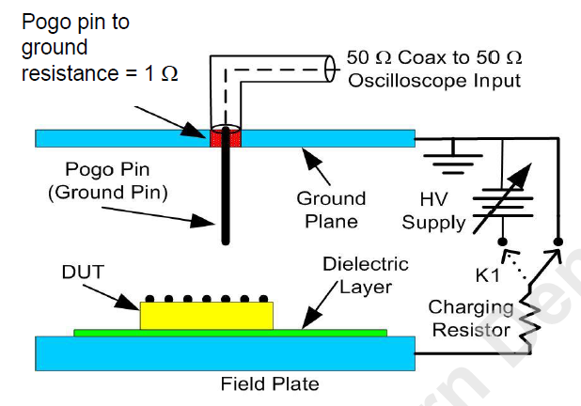
What is the problem?
Electrostatic discharge (ESD) events.
39 – 48% of all product failures in industry related to ESD.
JS-002-2018 test standard.
Used to measure discharge from a device.
Time-consuming to complete.
The most important parts are:
Pogo pin
Ground plane.
Device Under Test (DUT)
Oscilloscope
Notes:
Electrostatic discharge is a phenomenom, where a voltage potential is built up across two

Slide 3
What is electrostatic discharge?
Triboelectrification.
Electrons are transferred between materials when there is contact.
Charges build up on the two materials.
Electrostatic discharge.
The material between the two charges breaks down.
A conducting path is formed.
Charges move from one component to another.

Slide 4
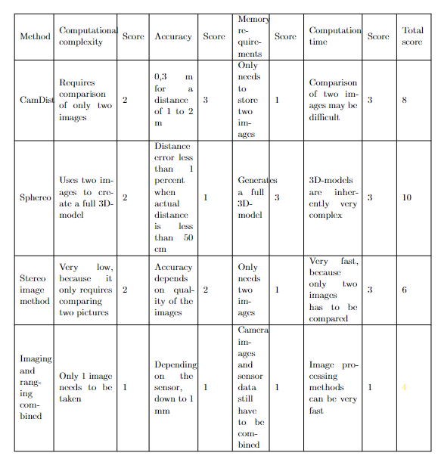
Different concepts for the solution.
CamDist
Sphereo
Stereo image method.
Imaging and ranging combined.

Slide 5
CamDist
Two pictures:
One picture taken at first.
Camera moves a set distance forward.
Second picture is taken.
Difference between the images gives the distance to the object.

Slide 6
Sphereo
Two balls used to generate two images.
Triangulation performed on the two images to generate a 3D-map.

Slide 7
Triangulation.

Slide 8
Stereoscopic imaging.
Using the difference between two images to determine depth of a scene.

Slide 9
Imaging and ranging combined
One camera used in combination with a range-finding sensor to determine position and range.

Slide 10
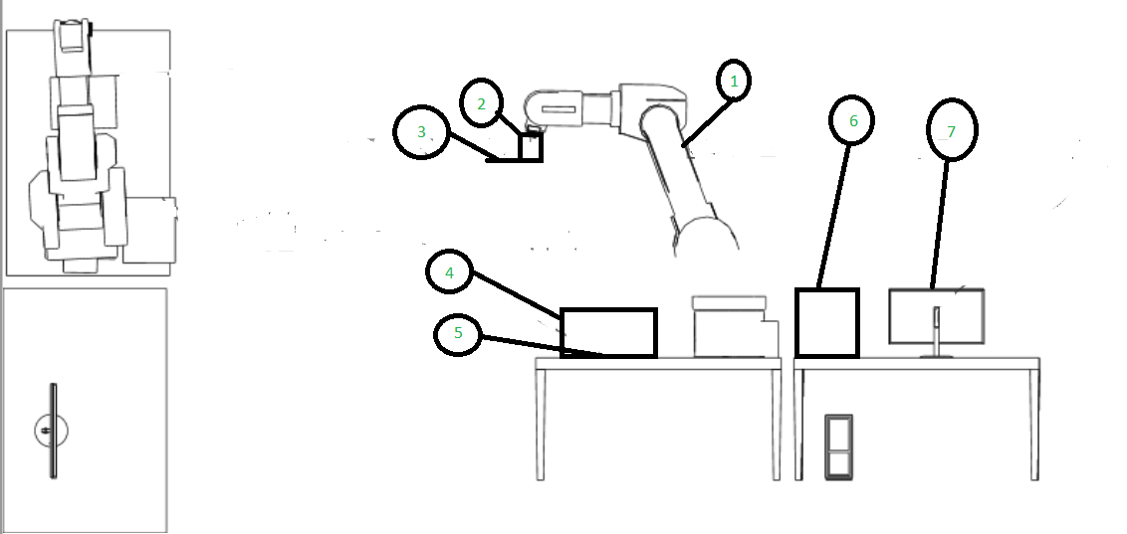
The concept.
A Kawasaki robot arm
A holder consisting of three parts:
Robot tool strut.
Ground plate.
Sensor mount.
A distance sensor and a camera.
A box designed to eliminate shadows.
The Device Under Test (DUT)
An oscilloscope.
A computer used to control everything.

Slide 11
The holder.
The holder is designed to accommodate:
A ground plate.
10 1-ohm resistors.
A pogo pin.
A distance sensor and camera.
The holder consists of three parts:
A robot tool strut.
A ground plate.
A sensor mount.

Slide 12
Hardware.
See3 Cam 130.
VL53L4CD distance sensor.
Force-sensitive resistor.
Oscilloscope.

Slide 13
See3 Cam 130

Slide 14
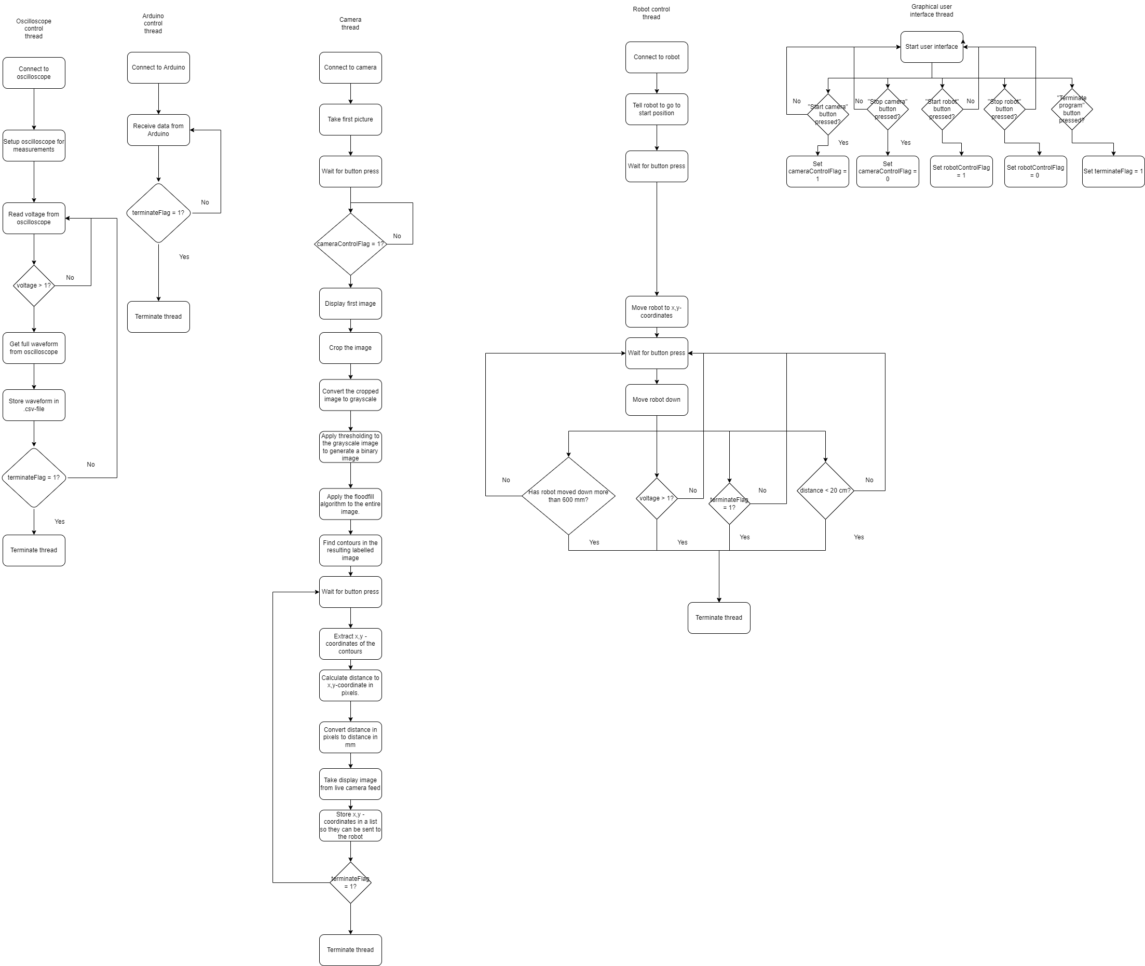
The software concept.
Five threads:
Oscilloscope.
Arduino.
Robot control.
Video.
Interface.
The most important threads are:
Video
Robot control

Slide 15
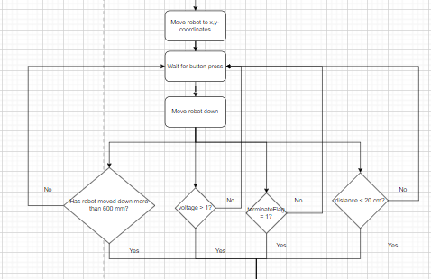
Robot control
Steps:
Move robot to x,y-coordinates.
Wait for button press.
Move robot down.
Stop the robot if:
Robot has moved down more than 600 mm.
The measured voltage is above 1 V.
TerminateFlag is set to 1.
The measured distance is below 20 mm.

Slide 16
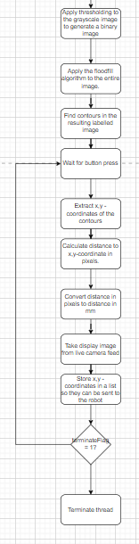
Video thread
Steps:
Generate a binary image.
Apply floodfill.
Find contours in the resulting image.
Wait for button input.
Extract x,y – coordinates.
Calculate distance to coordinates.
Convert distance to mm.
Send distance to robot.

Slide 17
Image processing
Grayscale.
Thresholding.
Finding contours.
Finding x,y-coordinates.

Slide 18
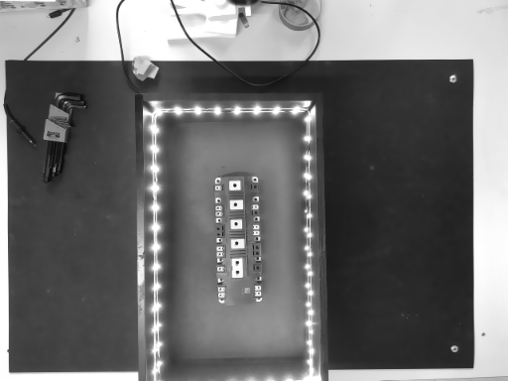
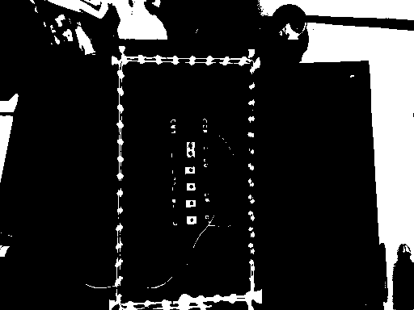
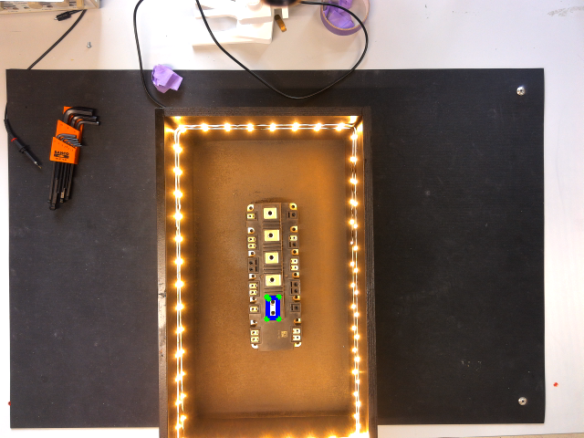
Image processing theory.
Grayscale:
Combine the three color channels into one channel.
Value then represents the intensity of light.
Thresholding:
Convert the grayscale image into a binary image.
If intensity is above a threshold value: 255.
If intensity is below a threshold value: 0.
Finding contours:
findContours()-function from OpenCV.
Extracting x,y-coordinates:
The boxPoints()-function from OpenCV.

Slide 19
Image segmentation
Possible methods:
Watershed.
K-means segmentation.
Color segmentation.
Contour segmentation.
Template matching.
Floodfill.

Slide 20
Watershed
Topographical map of the intensity.
Peaks and valleys.
Valleys are filled up.
Conflicts between labels give borders.

Slide 21
K-means segmentation
Pixels are sorted according to their values.
Each group of pixels gets a separate label.

Slide 22
Color segmentation
The image is converted to HSV color space.
Hue.
Saturation.
Value.
Target has color within a certain range.
Image can then be split into ranges.

Slide 23
Contour segmentation
Convert to grayscale.
Canny edge detection.
Second derivative of the gradient between pixels.
Find the zero crossing.
Collect the contours in a list.
OpenCV findContours().
Looks for connected components in the binary image.
Generate a mask based on the contours.
Apply the mask to the original image.

Slide 24
Template matching.
Two images:
New image.
Template image.
Identify a series of keypoints in the template image and the new image.
Compare the different keypoints and return the matches between the keypoints.

Slide 25
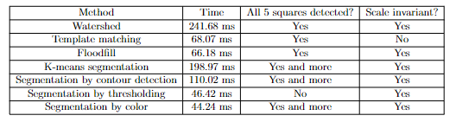
Comparison of the different methods

Slide 26
Floodfill.
How does it work?
Finding a seed point.
Visit the neighbouring pixels.
Mark them if they are unmarked.
When two neighbouring regions meet:
Note the conflict.
After the entire picture has been marked, resolve the conflict.

Slide 27
Experimental results.
Force-sensitive resistor.
Distance sensor.
Oscilloscope.

Slide 28
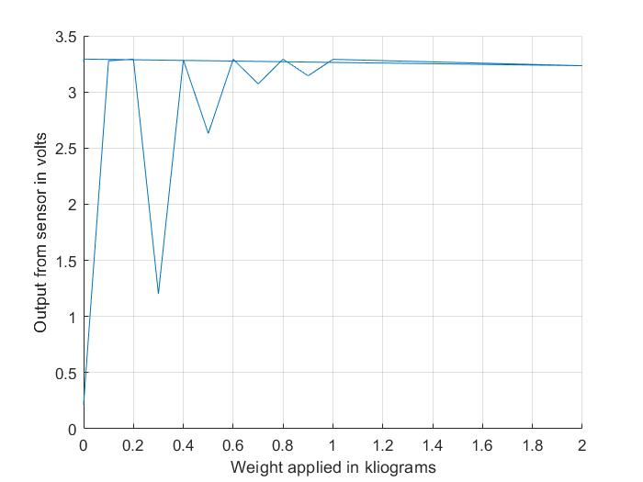
Test of force-sensitive resistor

Slide 29
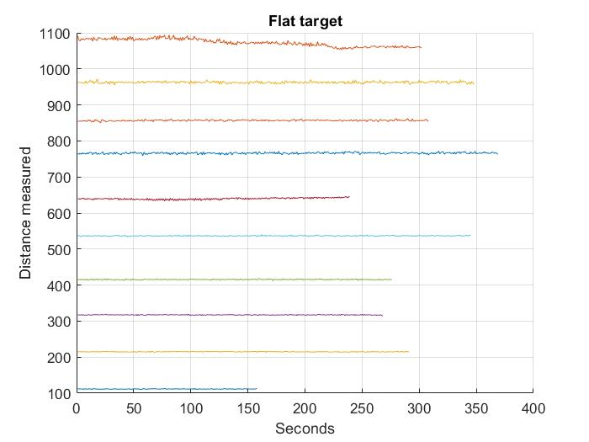
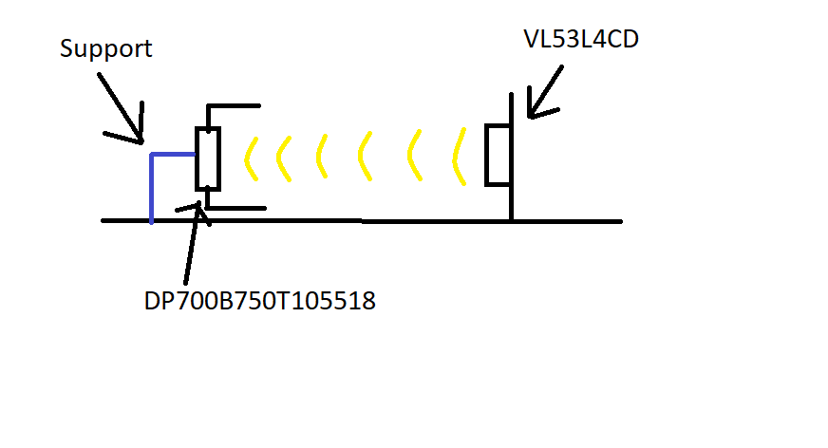
Test of VL53L4CD distance sensor.

Slide 30
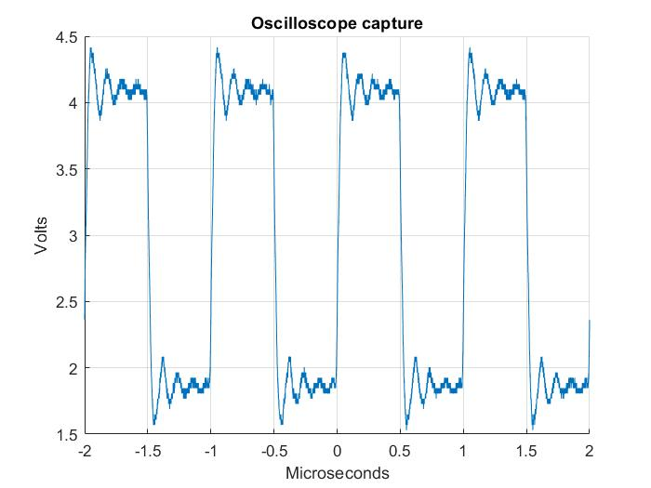
Test of oscilloscope capture.

Slide 31
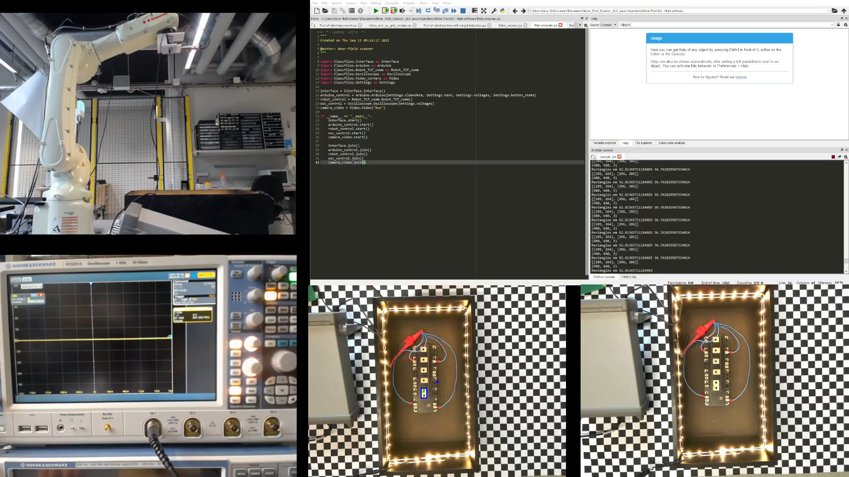
Acceptance test

Slide 32
Conclusion.
Design allows for one measurement to be taken on a charged unit.
Mechanical deisgn consists of three parts:
Robot tool strut.
Ground plate.
Sensor mount.

